Slide 1


Open source projects
with Python
Thomas Aglassinger
http://roskakori.at
https://github.com/roskakori/talks/linuxtage
@TAglassinger
Version 1.0.1

Slide 2
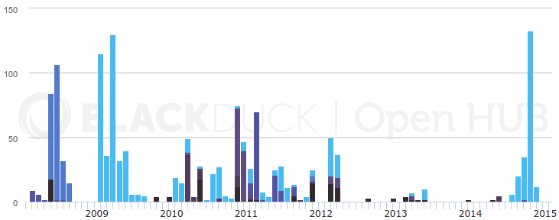
About me
1995: first open source commit
2001: master's degree in information processing science (Oulu, Finland)
2001: Systema Human Information Systems (Steyr, Austria)
2004: Raiffeisen Rechenzentrum (Graz, Austria)
“Casual” open source developer; Open Hub commit history:

Slide 3
Goals
Beginning from an empty folder a small open source project is published.
The project uses Python as programming language.
The project is easy to setup and maintain.
The project is easy to contribute to.
The project uses quality oriented approach and utilizes modern tools and best practices.

Slide 4
Intended audience
Developers who intend to start an open source project
People who are already working on open source Projects in Python
Anyone who wants to understand the processes and tools in the background of an open source project

Slide 5
Topics
Naming and licensing a project
The sample project: dividemo
Version management
Project structure
Writing a REAME
Build process
Testing and continuous integration
Version numbering
Static code checks
Merging contributions
Documentation
Launcher scripts
Publishing

Slide 6
Naming and licensing

Slide 7
Naming a project
No http://<project>.com
No clashes with existing open source projects:
https://github.com/LogIN-/ospnc
Other considerations:
https://www.farbeyondcode.com/Choosing-a-name-for-your-open-source-project--5-2700.html

Slide 8
Licensing
Many licenses to choose from: http://opensource.org/licenses
Basic choices: http://choosealicense.com/
Popular:
  GNU General Public License (GPL)
  GNU Library General Public License (LGPL)
  Apache License
  MIT License
  BSD License
For our simple example program: BSD License

Slide 9
The project: dividemo

Slide 10
Dividemo
Command line tool to divide two integer numbers and print the result to the standard output:
$ python dividemo.py 8 2
4
$ python dividemo.py 11 3
3
$ python dividemo.py 11 three
usage: dividemo.py [-h] DIVIDEND DIVISOR
dividemo.py: error: argument DIVISOR: invalid int value: 'three'

Slide 11
Source Code
import argparse
import math
import sys
def divided(dividend, divisor):
return dividend // divisor # //=integer division
def main(arguments):
# Parse command line arguments.
parser = argparse.ArgumentParser(description='divide two integer numbers.')
parser.add_argument('dividend', metavar='DIVIDEND', type=int, help='number to divide')
parser.add_argument('divisor', metavar='DIVISOR', type=int,help='number to divide by')
args = parser.parse_args(arguments)
# Process arguments and print result.
result = divided(args.dividend, args.divisor)
print(result)
if __name__ == '__main__':
main(sys.argv[1:])

Slide 12
Store the source code
$ cd ~/workspace # (or something the like)
$ mkdir --parents dividemo/dividemo
$ $EDITOR dividemo/dividemo/dividemo.py

Slide 13
Version management

Slide 14
Version management - goals
Changes can be tracked
Other people can easily contribute
Improvements can be merged easily
Mistakes in the code can be undone by reverting to a working version

Slide 15
Popular services
https://github.com
https://bitbucket.com
http://sourceforge.net

Slide 16
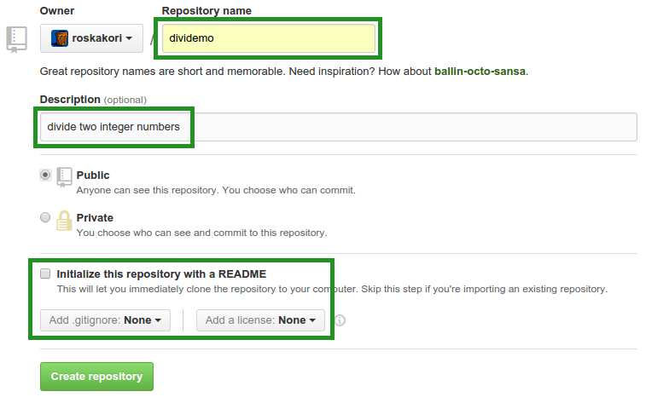
Create a project on Github

Slide 17
Project repository URL
Depend on username and project name
https://github.com/roskakori/dividemo.git

Slide 18
Project structure

Slide 19
Project structure
“5 Simple Rules For Building Great Python Packages”: http://axialcorps.com/2013/08/29/5-simple-rules-for-building-great-python-packages/
Pyscaffold can help to putup a new project from scratch: https://pypi.python.org/pypi/pyscaffold

Slide 20
Pyscaffold
Builds a scaffold for a new project
Preconfigures helpful utilities
$ cd ~/workspace # (or something the like)
$ putup --description "divide two integer numbers" --url https://github.com/roskakori/dividemo --license "simple-bsd" --with-travis --with-tox dividemo --force

Slide 21
Connect with Github
$ git remote add origin https://github.com/roskakori/dividemo.git
$ git push -u origin master
To avoid entering the Github password on each push: https://help.github.com/articles/generating-ssh-keys/

Slide 22
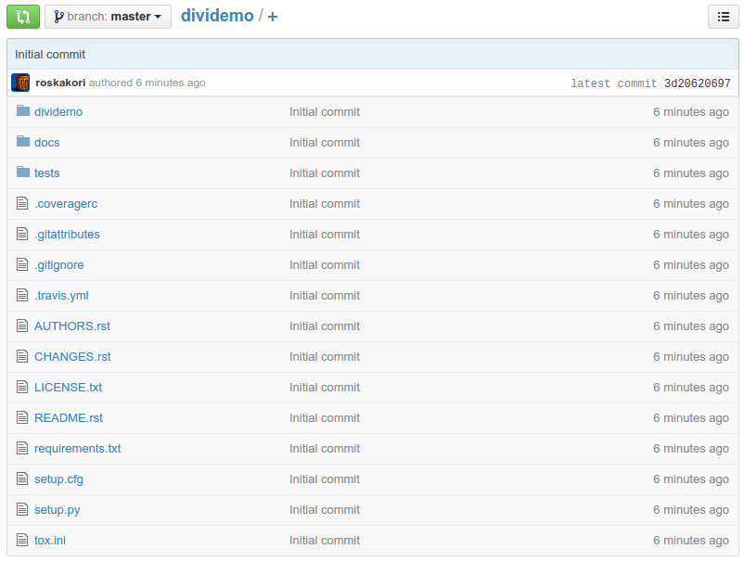
...and the result:

Slide 23
Writing a README
Should contain:
  Short summary of use
  Possibly a concise example
  Reference to license, documentation, source code
  Where to get support? (email, issue tracker)
For small applications: README = documentation
Format: ReStructured Text or Markdown
Online editor: http://rst.ninjs.org/

Slide 24
README.rst
Dividemo
========
Dividemo is a command line tool that divides two integer numbers and prints the result in the console.
Example::
$ dividemo 11 4
2
For more information, visit https://dividemo.readthedocs.org.
To get support, open an issue at https://github.com/roskakori/dividemo/issues.
The source code is available from https://github.com/roskakori/dividemo.
License
-------
Copyright (c) 2015, Thomas Aglassinger. Distributed under the BSD license. See LICENSE.txt for more information.

Slide 25
Build process

Slide 26
Setup.py (1/2)
Acts both as
  Installer
  Build tool
Supported by standard library (distutil)
Most things are are simple declarations (e.g. license, author, dependencies)
If necessary, all functions of the Python library can be used
→ no limited “scripting language” like make, ant, ...

Slide 27
Setup.py (2/2)
Has several built in commands, e.g. build and install the package
External packages can add additional commands (e.g. pip, wheel)
You can also add your own commands
→ pure Python code directly in setup.py

Slide 28
Build package
python setup.py sdist
build source distribution as *.tar.gz
python setup.py sdist --formats=zip
build source distribution as *.zip
Python setup.by bdist_wheel
build binary distribution as wheel;
requires wheel package, see https://pypi.python.org/pypi/wheel

Slide 29
requirements.txt
Describes dependencies to other Python packages that need to be installed
Simple syntax; one line per package
Example: requests >= 2.6.2
→ requires requests package, version 2.6.2 or later
Pip automatically installs packages described in requirements.txt

Slide 30
Installation
python setup.py develop
“Install” current development source code
(make it part of PYTHONPATH)
python setup.py install
Install package in current virtualenv, see https://pypi.python.org/pypi/virtualenv
sudo python setup.py install
Install package in system folders

Slide 31
Testing

Slide 32
A test program
import unittest
from dividemo import dividemo
class DividemoTest(unittest.TestCase):
def test_can_divide(self):
self.assertEqual(2, dividemo.divided(10, 5))
def test_can_print_divided(self):
dividemo.main(['10', '5'])
def test_fails_on_non_integer_divisor(self):
self.assertRaises(SystemExit, dividemo.main, ['10', 'hello'])

Slide 33
Run test suite
Requires configuration or automatic configuration by PyScaffold
python setup.py test
Runs test suite, reports result and builds HTML report about test coverage
Coverage reports is located in folder “htmlcov”.

Slide 34
Continuous integration
After each push to the version management repository, run the test suite → make you aware of new bugs early
Travis - https://travis-ci.org/
  Github informs Travis about new push
  Travis runs tests
  If tests fail, Travis sends e-mail
  Test log is available online
Jenkins - http://jenkins-ci.org/
  Can be deployed locally
  Python setup: http://www.alexconrad.org/2011/10/jenkins-and-python.html

Slide 35
.travis.yml
language: python
sudo: true
virtualenv:
system_site_packages: true
env:
matrix:
- DISTRIB="ubuntu" PYTHON_VERSION="2.7" COVERAGE="true"
- DISTRIB="conda" PYTHON_VERSION="2.7" COVERAGE="false"
- DISTRIB="conda" PYTHON_VERSION="3.3" COVERAGE="false"
- DISTRIB="conda" PYTHON_VERSION="3.4" COVERAGE="false"
install:
- source tests/travis_install.sh
- pip install -r requirements.txt
before_script:
- git config --global user.email "roskakori@users.sourceforge.net"
- git config --global user.name "Thomas Aglassinger"
script:
- python setup.py test
after_success:
- if [[ "$COVERAGE" == "true" ]]; then coveralls || echo "failed"; fi
cache:
- apt

Slide 36

Activate travis
Visit https://travis-ci.org/profile
Click
Enable project:

Slide 37


Coveralls
Online test coverage reports
Add a repository: https://coveralls.io/repos/new
(even for open source repos)

Slide 38
Time to git push!

Slide 39
Version numbering

Slide 40
Pythoner version numbering
Guidelines: “PEP 440 - Version Identification and Dependency Specification” https://www.python.org/dev/peps/pep-0440/
Easy but cumbersome: manual maintenance in __init__.py: __version__ = '1.2.3'

Slide 41
Version numbering with Pyscaffold
“Magic” in _version.py:
$ python
>>> from dividemo import _version
>>> _version.get_version()['version']
'0.0.post0.dev2+g8cdc4ea'

Slide 42
Advancing the version
Add a new git tag:
$ git tag -a -m "Tagged version 0.1.0." v0.1.0
$ git push --tags

Slide 43
Trove classifiers
Describe package
Make it easier for users to find it
Available classifiers:
https://pypi.python.org/pypi?%3Aaction=list_classifiers

Slide 44
Add trove classifiers
Setup.py
With Pyscaffold: setup.cfg

Slide 45
Dividemo trove classifiers
classifiers = Development Status :: 4 - Beta,
Environment :: Console,
License :: OSI Approved :: BSD License,
Operating System :: OS Independent,
Programming Language :: Python,
Programming Language :: Python :: 2,
Programming Language :: Python :: 3,
Topic :: Utilities

Slide 46
Meanwhile...

Slide 47
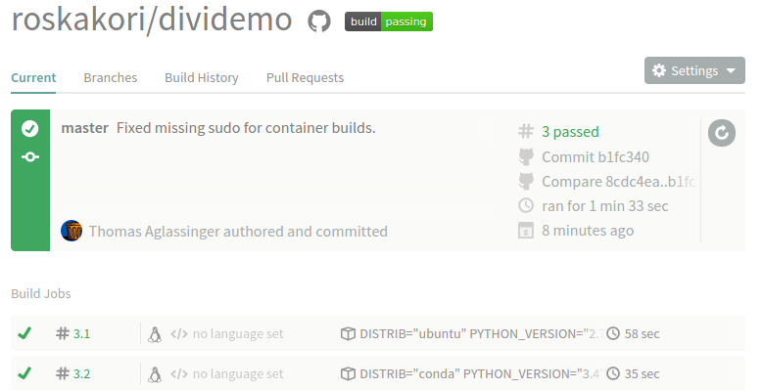
Travis finished

Slide 48
Static code checks

Slide 49
Static code checks
Identify possibly issues by scanning the source code
PEP8 Style guide for Python code http://legacy.python.org/dev/peps/pep-0008/
“Code smells”, e.g. unreachable or unused code
Intended to improve general code quality and simplify maintenance

Slide 50
flake8
Finds formatting issues and a few code smells
Pragmatic and low volume
$ tox -e flake8
dividemo/dividemo.py:5:1: F401 'math' imported but unused
dividemo/dividemo.py:11:1: E302 expected 2 blank lines, found 1
dividemo/dividemo.py:14:80: E501 line too long (90 > 79 characters)
dividemo/dividemo.py:15:64: E231 missing whitespace after ','
...

Slide 51
Pylint
http://www.pylint.org/
Provides many checks
Default setting: very verbose, lots of noise
Simple front end: https://landscape.io/
Based on prospector https://pypi.python.org/pypi/prospector

Slide 52
Managing contributions

Slide 53
Pull requests
Feature of Github and Bitbucket
Makes it easy to review, iterate and merge changes from another fork
Sadly no live presentation due lack of time ggg:-(

Slide 54
Documentation

Slide 55
Sphinx documentation
“Sphinx is a tool that makes it easy to create intelligent and beautiful documentation”
http://sphinx-doc.org
Based on ReStructured Text markup
Easy linking and cross referencing
Automatically builds index and search page
Extract API documentation from source code

Slide 56
Sphinx configuration
docs/conf.py
Manually: docs/Makefile
Pyscaffold:
Possibly have to set theme in conf.py:
html_theme = 'default'
Possibly trim option intersphinx_mapping
HTML results are located in “docs/_build/html”
$ python setup.py docs

Slide 57
Publishing the documentation
https://readthedocs.org
After push to repository, rebuild and publish the documentation
Dashboard > Import a project > From Github
Wait for build to finish
Read it at https://dividemo.readthedocs.org

Slide 58
Launcher script

Slide 59
Launcher scripts
To just run “dividemo” instead of “python ...”
Add pointer to main() function in setup.cfg:
[console_scripts]
dividemo = dividemo.dividemo:main

Slide 60
Publish to the
Python Package Index (PyPI)

Slide 61
PyPI first time setup
Prepare ~/.pypirc:
Register you project:
[distutils]
index-servers=pypi
[pypi]
repository=https://pypi.python.org/pypi
username=roskakori
password=.....
$ python setup.py register

Slide 62
Publish a new version
$ git tag -a -m "Tagged version 1.0.0." v1.0.0
$ git push –tags
$ python setup.py sdist --formats=zip upload

Slide 63
Summary

Slide 64
Summary
Many helpful tools for Python projects
  Flake8, git, pip, Pyscaffold, sphinx
Many helpful services
  Coveralls, Github, PyPI, Readthedocs, Travis
Easy collaboration with Github and Pull requests
Python is fun!

